Slide 1

Concepts for Client – Shell Osborne
Team Fermata
Glittika Gerdmanee (Nancy), Doug Tilden (Richard), Wing Him Choi, Tiarna Kilmister, Finn Perry

Slide 2
Team Members
Glittika Gerdmanee (Nancy) - Designer
Strengths:
Narrative Design
2D Digital Art
Concepting
Weaknesses:
Horror Concepts
Scripting (Coding)
Wing Him Choi - Artist
Strengths:
Rigging
Animation
Creature Modeling
Weaknesses:
2D Art
Retopology
Tiarna Kilmister - Artist
Strengths:
Character Modeling
ZBrush
Texturing
Weaknesses:
Skinning
Hard surface modeling
Finn Perry - Programmer
Strengths:
Back-End Systems
Tools
Weaknesses:
Programming for Front End
Gameplay

Slide 3
Fireball!
Battle against your friends in the Baby Dragons’ Playgrounds as you Fireball critters for the highest score in this action-packed party game!
2-4 Players
Premium (Single Purchase)
PC
Casual players

Slide 4
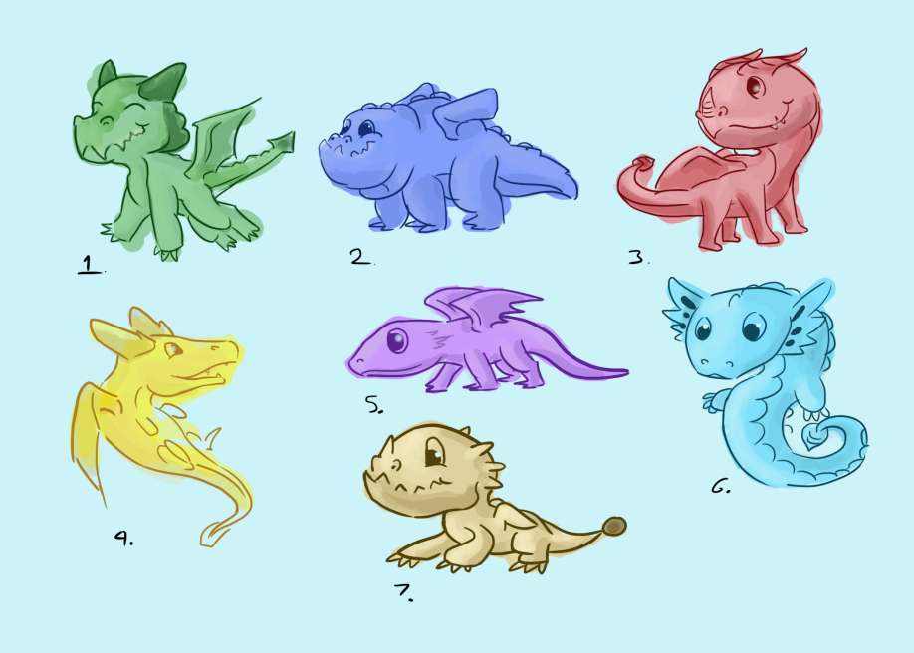
Fireball!
Core Experiences
Fast-paced Competitive Action
Vibrant, adorable visuals
Master a Variety of Arenas
Key Features
Trove of Power-Ups
Multiple Arenas
Cute Colourful Dragons

Slide 5
Orchestra
Play your heart out and fight for the spotlight for your time to shine with the instrument of your choice!
2-4 Players
Premium (Single Purchase)
PC
Casual players

Slide 6
Orchestra
Core Experiences
Fast-paced Competitive Action
Master Multiple Stages
Part-Rhythm gameplay
Key Features
Cutesy Cartoon Instruments
Amazing Soundtrack
Unique Powers

Slide 7
The Detonator in Me
Play as an unfortunate fellow with a detonator inside them, stuck in a room with a bomb that will explode if they get too close.
1 Player
Premium (Single Purchase)
PC
Fans of puzzle games

Slide 8
The Detonator in Me
Core Experiences
Escape Room Puzzles
Two Options for Victory
Tense Atmosphere
Key Features
Cartoony Graphics
Bomb Changes Location

